Slide 1

BearQuest
By Arantxa Rodriguez, Cameron Cole, Mark DeJarnett & Matthew Darby

Slide 2
What is bearquest?
BearQuest is a text-based Baylor RPG that aims to be a text game adventure set in the perspective of a Baylor Computer Science student’s daily life. This adventure is filled with all the quirks and inside humor a typical undergrad may encounter.

Slide 3
Features of bearquest
Battle system
Story-based adventure
Real Baylor buildings and situations
Computer Science Professors as Enemies

Slide 4
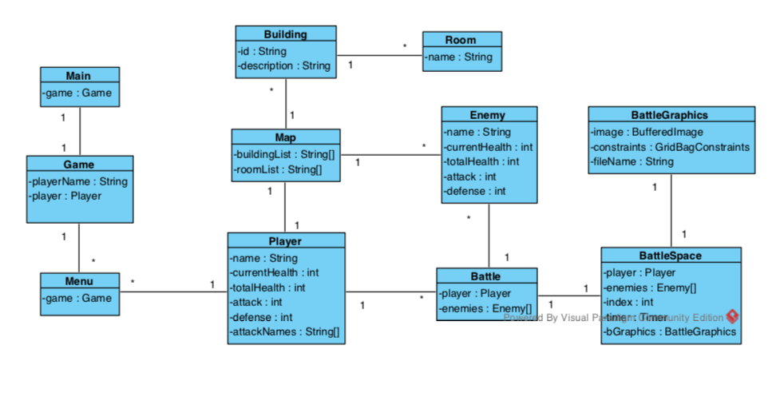
Domain Model

Slide 5
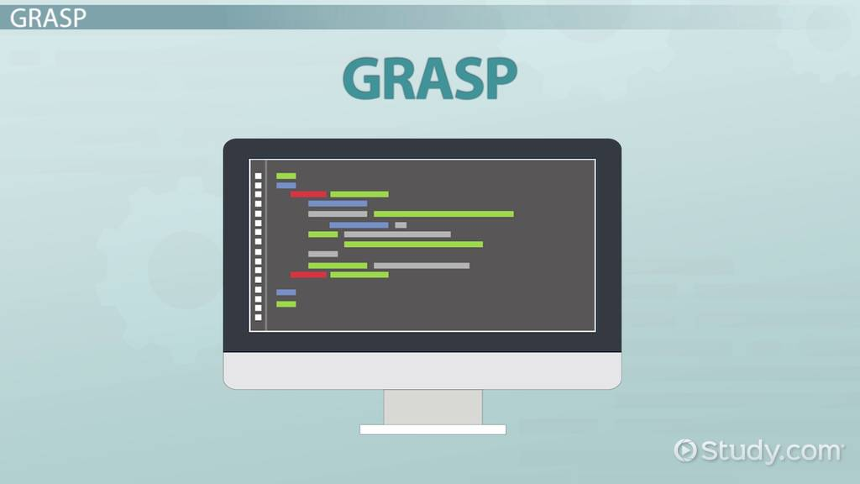
GRAPS
Information Expert
Creator
High Cohesion
Controller
Pure Fabrication
Indirection
Notes:
Information expert –
Creator –
High Cohesion –
Controller – have a window class that manages windows
Polymorphism – have classes that extend others
Pure Fabrication – have
Indirection -

Slide 6
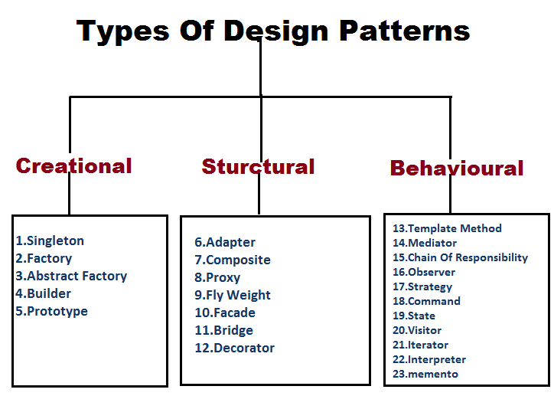
Design Patterns
Façade
Prototype
Builder
Proxy
Chain of Responsibility
Mediator
State
Notes:
Façade –
Prototype –
Builder –
Proxy –
Chain of Responsibility –
Mediator –
State -

Slide 7
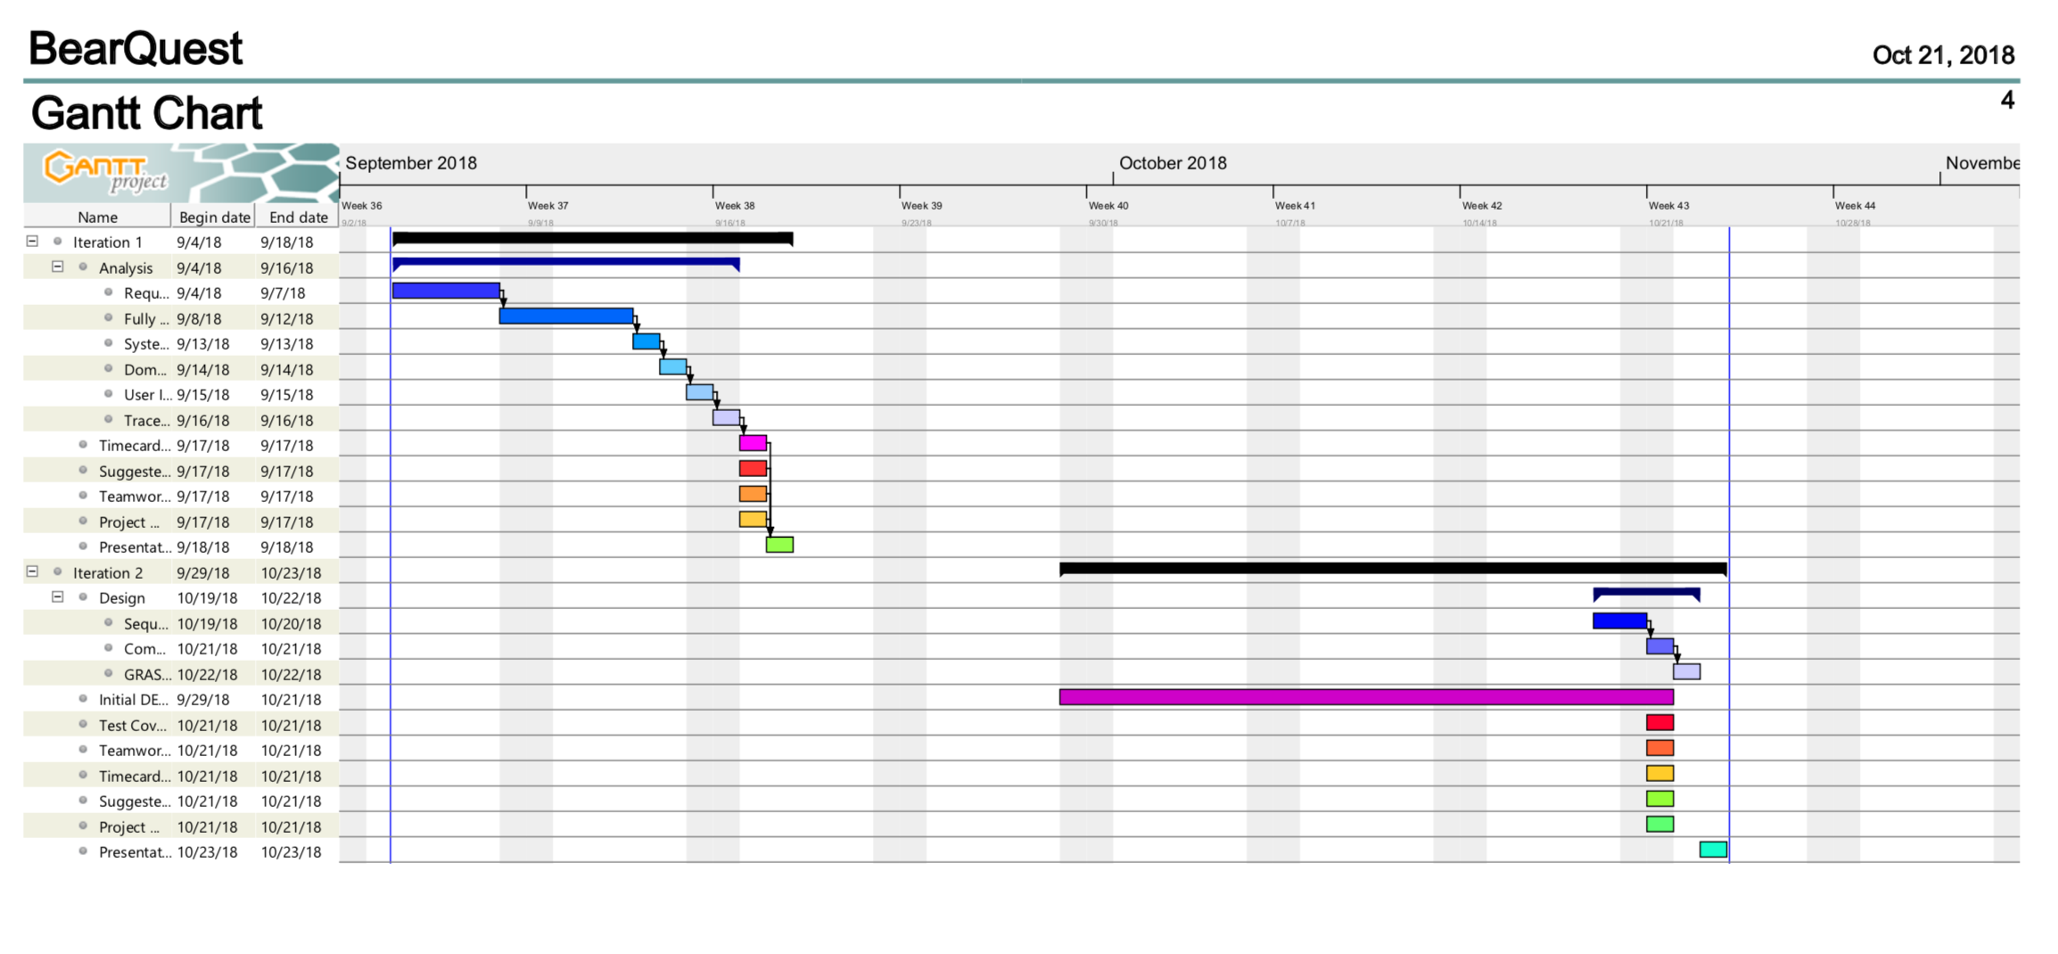
Project Plan

Slide 8
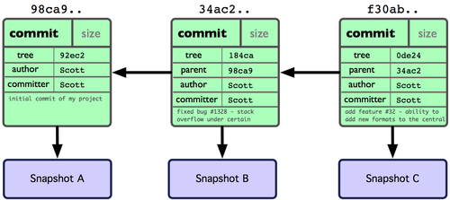

Git commit count
On website for more detail
Total of around 250 commits!

Slide 9
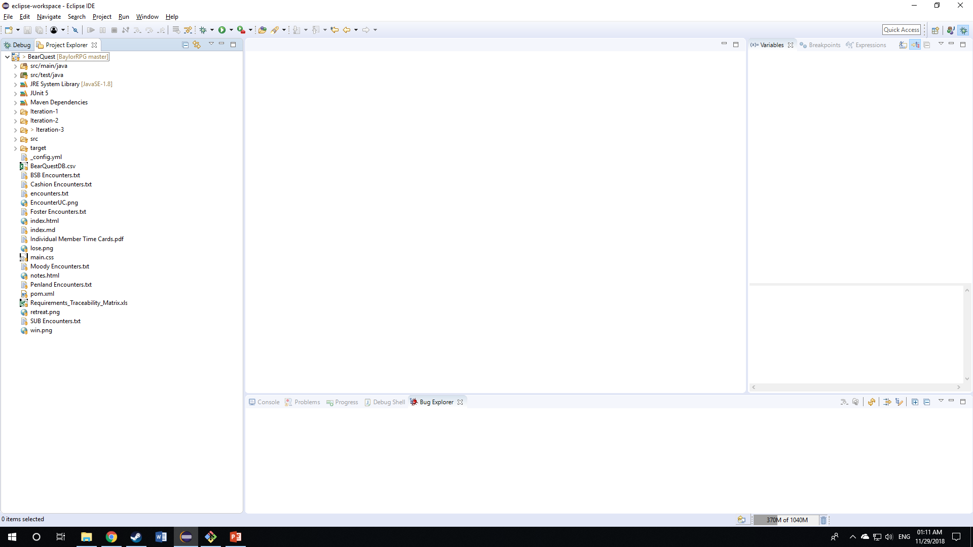
SpotBugs

Slide 10
Hours & Roles
Matt Darby – Git Specialist, Map Designer and Website Engineer
Mark DeJarnett – Battle Engineer and Test Designer
Cameron Cole – Team Leader and Production Manager
Arantxa Rodriguez – Menu and Game Designer/Engineer
Project Time Card
Name Hours Grade Distribution
M. Darby 89 25%
M. DeJarnett 89 25%
C. Cameron 89 25%
A. Rodriguez 89 25%

Slide 11
Questions?

